Slide 1
The Applications of Automata in Game Theory
Aryaman Mishra 19BCE1027

Slide 2
Introduction
In game theory, presenting players with strategies directly affects the performance of the players. Utilizing the power of automata is one way for presenting players with strategies. In this chapter, the authors studied different types of automata and their applications in game theory. They found that finite automata, adaptive automata, and cellular automata are widely adopted in game theory. The applications of finite automata are found to be limited to present simple strategies. In contrast, adaptive automata and cellular automata are intensively applied in complex environment, where the number of interacted players (human, computer applications, etc.) is high, and therefore, complex strategies are needed.

Slide 3
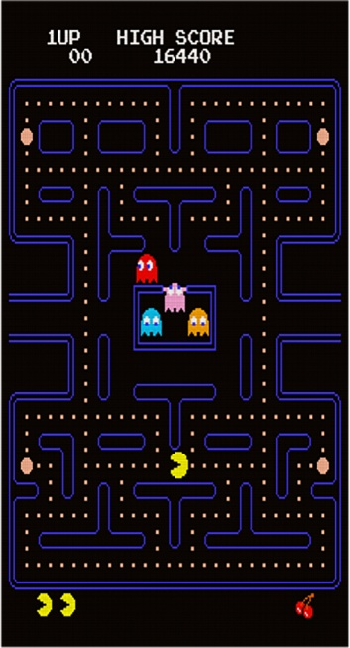
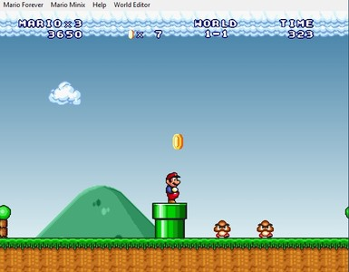
Let’s Start with the Basics
Any problem with interacted participants and actions can be treated as a game. When car drivers put a plan to drive in heavy traffic, they are actually playing a driving game. When users bid on bidding-based Websites, they are actually playing an auctioning game. In election, choosing the platform is a political game.
The owner of a factory deciding the price of his product is an economic game. Obviously, game theory can be presented in wide range of applications. Game theory is a mathematical tool that can analyze the interactions between individuals strategically. The interactions between agents, who may be individuals, groups, firms are interdependent. These interdependent interactions are controlled by the available strategies and their corresponding payoffs to participants. However, game theory studies the rational behavior in situations involving interdependency (McMillan, 1992). Therefore, game theory will only work when people play games rationally and it will not work on games with cooperational behavior.

Slide 4
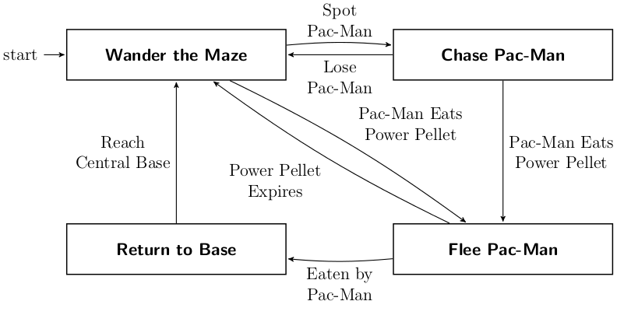
‘What’s in a game?’by a Gamer
Generally, the game consists of the following entities:
• Players: Where one side of the game tries to maximize the gain (payoff), while the other side tries to minimize the opponent’s score. However, these players can be humans, computer applications or any other entities.
• Environment: This includes board position and the possible moves for the players.
• Successor Function: The successor function includes actions and returns a list of (move, state) pairs, where each pair indicates a legal move and the resulting state.
• Terminal Test: The terminal test specifies when the game is over and the terminal state is reached.
• Utility Function: The utility function is the numeric value for the terminal states.

Slide 5
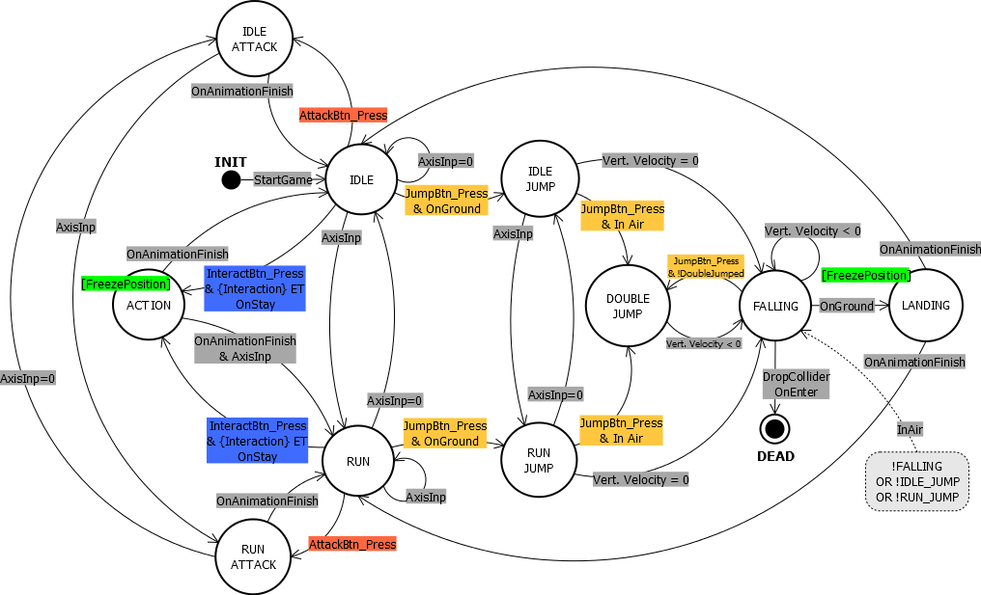
Visualization of an automata of Mario Forever in Unity Engine

Slide 6
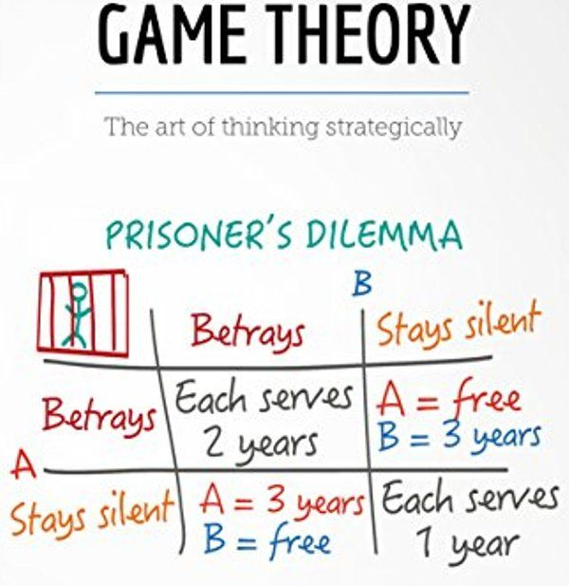
AUTOMATA TYPES
An automaton (plural: automata or automatons) is a self-operating machine. The output to one automaton is a combination between the consequences of the current input and the history of the machine’s previous input. An automaton is designed to automatically follow a predetermined sequence of operations or respond to encoded instructions. There are many types of well known automata, such as finite automata, turing machines, push–down automata, adaptive automata as well as other variations such as, random access machines, parallel random access machines and arrays automata. Experimental simulations of automata methods carried out in different researchers have recommended the automaton approach in the solution of many interesting examples in parameter optimization, hypothesis testing, and in game theory.

Slide 7
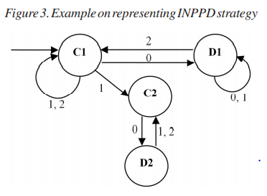
Example of Finite Automata
Finite automata are widely used in game theory. For instance, in the iterated n-player prisoners’ dilemma (INPPD), finite automata can be used to represent players’ strategies. The automata states represent the players’ action and the input is the strategy profile observed from the other players (e.g. the number of cooperated agents). Therefore, if n represent the number of players in the game, then the set I is defined as I = {0, 1, …, n-1}. The set of states S can be divided two states C and D, such that the player cooperate or defect if st ∈ C or st ∈ D, respectively. Figure 3 shows an example of a strategy for the NPPD with 3 participants. The automaton presented in Figure 3 has four states: C1, C2, D1 and D2. The arcs between the states represent the transitions. The four states can only be triggered by the numbers associated with the arcs, resulting in a transition between the states. In this example, F(C1, 0) = D1 and F(D2, 2) = C2, and so on. The initial state is the one with an empty arrow in its direction (S0 = C1). The following sequence of plays illustrates the role which finite automata can play in representing strategies: • First, the player selects “C” as its initial state. • If in this round none of the other two players played “C”, the total number of cooperator will be 0 (excluding the player itself).

Slide 8
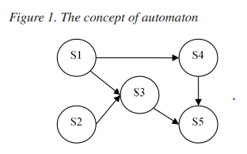
Diving deep into Automata Theory
A learning automaton operates in a random environment. The actions are chosen based on the inputs received from the environment to find the optimal. The learning schemes come in two structures: fixed structure and variable structure. Fixed structure schemes in stationary random environments are described by homogeneous Markov chains. On the other hand, variable structure schemes are described by Markov processes. Much of the effort in these areas has been directed towards achieving expedient, optimal behavior.However, learning automaton has a finite number of output actions, one of which is selected at each instant. Every selected action will be either rewarded or punished by the environment, which leads to update the probability distribution defined over the actions. Choosing the proper updating algorithms, leads to desirable asymptotic behavior of the learning automaton.

Slide 9
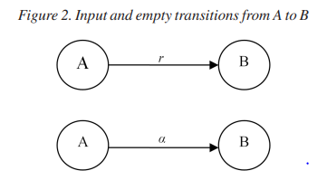
Finite State Automata
Finite automaton is one of the well-studied computation models in theoretical computer science. Finite automata are composed of fixed finite memory, which takes its decisions using that finite memory, a finite non-empty alphabet, a transition function, an initial state and a set of final states. Transitions map ordered pairs specifying the current state and the current input symbol into a new state. Finite Automata are classified into Deterministic Finite Automaton (DFA) and Non-Deterministic Finite Automaton (NFA). DFA is only permitted to be in one state in any time. On the contrast, NFA can be in two or more states at any given time. Technically, adding restrictions to DFA is sufficient to transform it to NFA. However, there are two types of transitions from state A to state B: Input transitions (A, r) → B, with an input symbol r, and Empty transitions (A, α) → B, which do not modify the input.

Slide 10
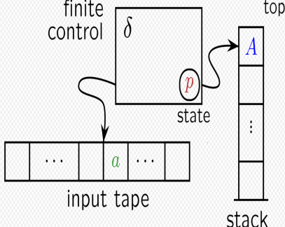
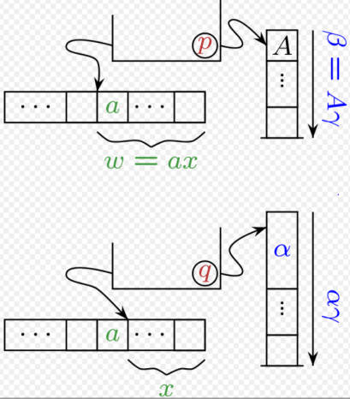
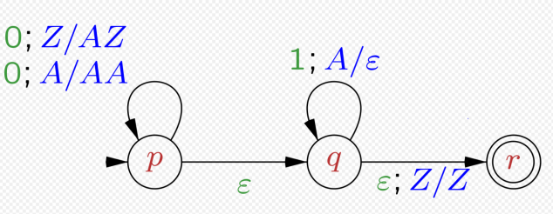
Pushdown Automata
The pushdown automata are finite automata equipped with stack. Several operations can be applied on the stack including read, push and pop operations. Mathematically, pushdown automata can be defined as a septuple R as follows: R= (S; α; Г; δ; I0 ; Z0 ; F)
• State Tuples: This category includes tuples S, I0 and F, such that:
◦ S is a finite set of states. ◦ I0 is the initial state of the pushdown automata.
◦ F is the final (acceptance) state.
• Input Tuples: This category includes tuples α and Z0 , such that:
◦ α is a finite set of input symbols.
◦ Z0 is the initial input symbol to pushdown automata.
• Stack Tuples: This category includes tuple Г, such that:Г is finite stack alphabets that are allowed to be pushed onto the stack.
• Transition Tuples: This category includes tuples δ, such that:
◦ δ is the transition function, where δ is designed to control the behavior of the automaton. ◦ The function δ takes three arguments (m, n, r), where m is a member in S, n is a member in α and r is a member in Г. The output of this function is a finite set of pairs (p, q), where p is the new generated state and q is the string of the stack that replaces r from the top of the stack.

Slide 11
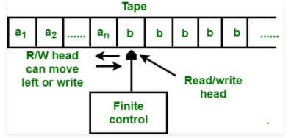
Turing Machine
A Turing machine is an abstract computing device which consists of a finite control, unbounded memory (represented by tapes), and a finite program. The program is a list of instructions that guide the machine to take actions based on the current state of its finite control and the bits in its current ‘window’ on the information on the tapes. A step normally involves both a change of state in the finite control, a rewrite of the bits in the window, and a move of the window to the left or to the right by one position Turing Machines were first proposed by Alan Turing .The idea was to model what humans do in order to solve a problem when following instructions through symbolic means. Alan tried to extract the basic entities of the process together with the basic operations that allow a computer to carry out the process of following a set of instructions. Turing machine assumes that at the entire input data is available on the input tape at the beginning of the computation. The rest of the input tape is blank. If the machine approaches the accepting state, the input is said to be accepted. The result of the computation is given by the contents of the tapes at this time. Once a new set of input data is started, all previous information will be erased. The framework of Turing machines is suitable for studying the power and efficiency of algorithms, considering the achievements of computability and complexity theoryTechnically, Turing machines are extended versions of pushdown automata. Similar to the transition function (δ) in pushdown automata, Turing machine has a central component which can be in one of a finite number of states and an infinite tape used for storage. However, several characteristics are responsible for distinguishing Turing machines from pushdown automata, :
• The tape used by a Turing machine is infinite in both directions.
• Turing machine receive its input written on the tape which they use for storage.
• Turing machine control the head position to where reading and writing on the tape is performed.

Slide 12

Implementation of Turing Machine
R= (S; α; Г; δ; I0 ; B; F) where the tuples of R are classified into the following categories:
• State Tuples: This category includes tuples S, I0 and F, such that:
◦ S is a finite set of states.
◦ I0 is the initial state of the Turing machine.
◦ F is the final (acceptance) state.
• Input Tuples: This category includes tuples α and B, such that:
◦ α is a finite set of input symbols.
◦ B is the blank symbol. B is a member in Г but not in α. The blank appears initially in all but the finite number of initial cells that hold input symbols.
• Tape Tuples: This category includes tuple Г, such that:
◦ Г is a complete set of tap symbols.
• Transition Tuples: This category includes tuples δ, such that:
◦ δ is the transition function, where δ is the central processing part of Turing machine.
◦ The function δ takes three arguments (t, u, d), where t is the next state, u is a symbol in Г that is written in the cell being scanned, replacing whatever symbol was there, and d is the direction (L: left and R:right), indicating the direction of the head tape. The output of this function is a finite set of pairs (p, q), where p is the new generated state and q is the string of the stack that replaces r from the top of the stack.

Slide 13
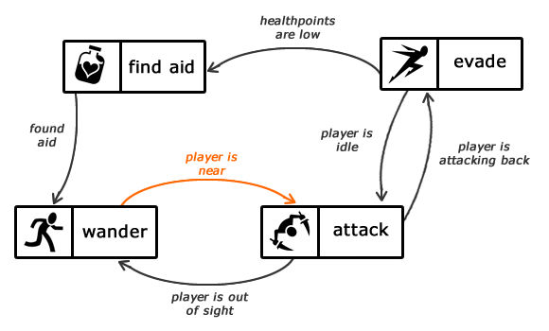
Applications of Automata in Game Theory
Automata theory has presented various types of automata with different characteristics. In this section we will go through the applications which have successfully utilized the concept of automata in game theory:

Slide 14
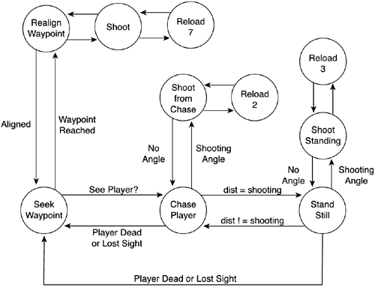
Applications of Finite Automata
Recently, Finite automata have been widely used to represent player strategies in game theory. On the other hand, there is a difference between the environments for representation the players in lattices, trees, or graphs using EAs techniques, based on many factors that in turn affect back the outcome of the evolution of strategies. Some of these factors include the number of players, technique of evolutionary computation, type of automata and neighborhood structures. In (Dworman, Kimbrough, & Laing, 1995) the authors have reported that they build their 3-players model using a genetic programming technique to discover highquality negotiation policies, where the behavior of the players was presented by finite automata. However, finite automata are found efficient in representing simple strategies in game theory. Nevertheless, game theory is interested in representing simple strategies since many real life applications do not require complex strategies to achieve their goals.

Slide 15
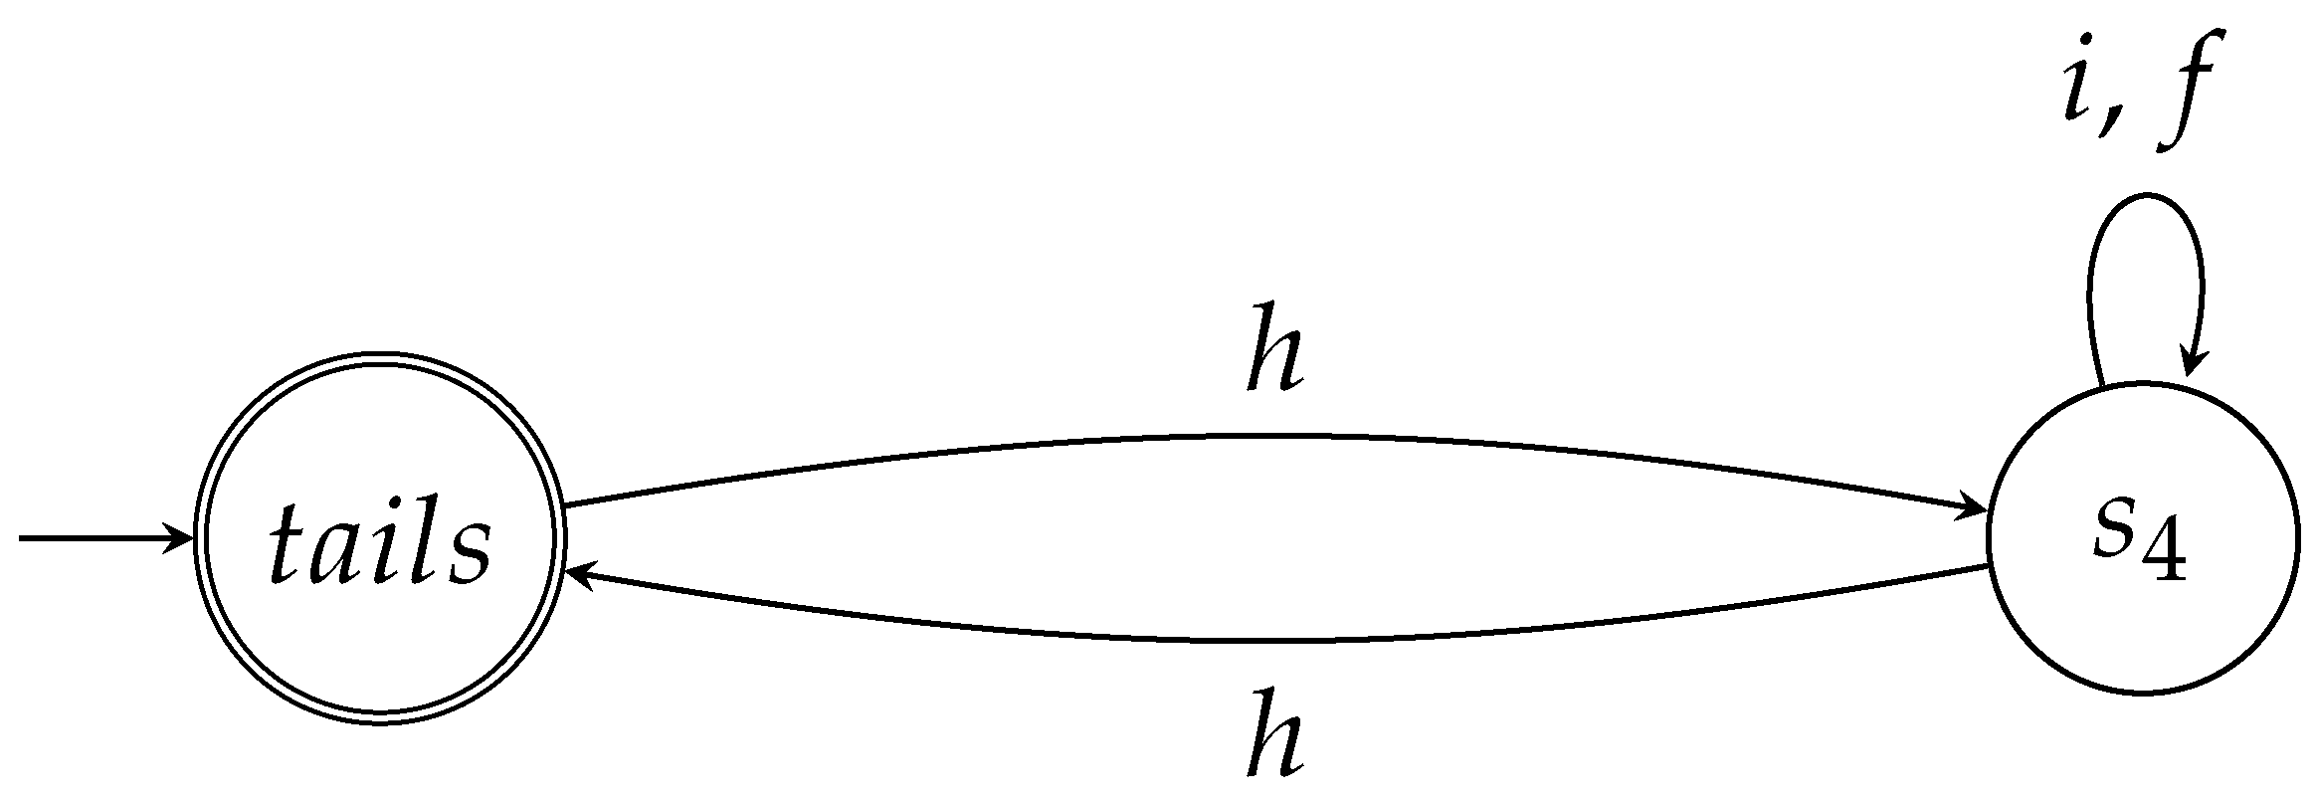
Applications of Adaptive Automata
Adaptive automata-based devices have been presented as powerful tools for defining complex languages. Adaptive automata have the following important features:
The accepting procedure performed by an adaptive automaton is done efficiently, due to their structure which is based on finitestate or structured pushdown automata.
• Adaptive automata can handle context dependencies in a strict syntactical way, without the aid of auxiliary semantic procedures.
• The structure of adaptive automata can extended to implement transducers, allowing the generation of parse trees as a side effect of parsing sentences.
• Generally, adaptive automata have cheaper implementations compared to other mechanisms.
• Adaptive automata can be considered as alternative to existing solutions of natural language processing.
In order for adaptive automata to do selfmodification, adaptive acts adhered to their state-transition rules are activated whenever the transition is used. Adaptive mechanism can be defined as Adaptive actions which change the behavior of adaptive automata by modifying the set of rules defining it. The simple notation for representing adaptive automata should have some features such as, being, at least, compact, simple, expressive, unambiguous, readable, and easy to learn, understand and maintainAdaptive automata have computational power equivalent to a Turing Machine Thus, strategies presented by adaptive automata may show more complex behaviors than the ones described by finite automata. For instance, learning mechanisms can be constructed using adaptive automata to represent adaptive learning mechanism based on specific input parameters. However, finite automata are a particular case of adaptive automata. If the automata have no rules associating adaptive functions to transitions, the model can be reduced to finite automata. This characteristic is considered important to use adaptive automata naturally where finite automata are required.

Slide 16

Conclusion
Presenting players strategies in game theory is one of the factors which affect the players’ performance significantly. In this work we have analyzed the characteristics and the underlying structure of existed types of automata. Consequently, we have explored the applications of automata in game theory. However, this study revealed that only few types of automata have been utilized in game theory. We found that finite automata have been widely used to represent simple agents’ behavior. On the other hand, adaptive automata and cellular automata are mainly used to represent complex agents’ behavior. The complexity level of both adaptive automata and cellular automata is determined by the number of states in the automata. The more states we have, the higher is the capability for those automata to handle complex strategies.

